Slide 1
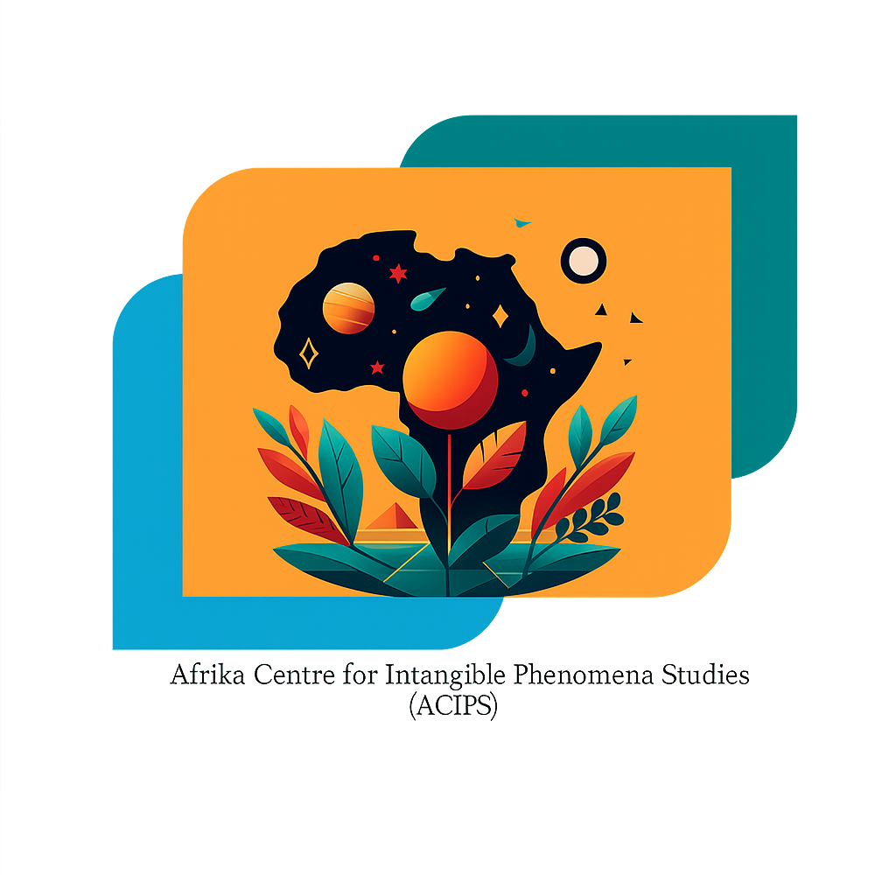
Gaining Understanding of Afrikan Spirituality and Indigenous Knowledge Systems
Bernard N. Owusu-Sekyere (MTh & MCom)
Founding Director ACIPS

Slide 2
Understanding Afrikan Spirituality
• Afrikan Spirituality is rooted in holistic cosmologies that connect the material, spiritual, and ancestral realms.
• It emphasises Ubuntu (human interconnectedness), reverence for ancestors, and sacred relationships with nature.
• Spirituality is a lived experience and knowledge system, rather than institutionalised religion.

Slide 3
Insights from Research on Intangible Phenomena
• Intangible cultural heritage includes oral traditions, rituals, cosmologies, and healing practices.
• UNESCO recognises these as critical for identity and sustainability.
• Recent scholarship explores African metaphysical practices as valid epistemologies (Ndlovu-Gatsheni, 2020).

Slide 4
Past, Present and Future of Indigenous Knowledge Systems
• Past: Colonisation suppressed and delegitimised IK systems.
• Present: Growing recognition of indigenous epistemologies in universities and policy.
• Future: Integration with technology and decolonial education reforms.

Slide 5
Specialisation, Training and Knowledge Exchange
• Need for formalised programmes in African spirituality and IK.
• Apprenticeship models and community-led training remain important.
• Knowledge exchange through digital platforms, academic partnerships, and oral transmission.

Slide 6
Conclusion
• Afrikan Spirituality and IK are foundational to the African Renaissance.
• Intangible phenomena must be taken seriously as epistemic resources.
• Future depends on systematic research, training, and cross-cultural exchange.

Slide 7

END

